Slide 1

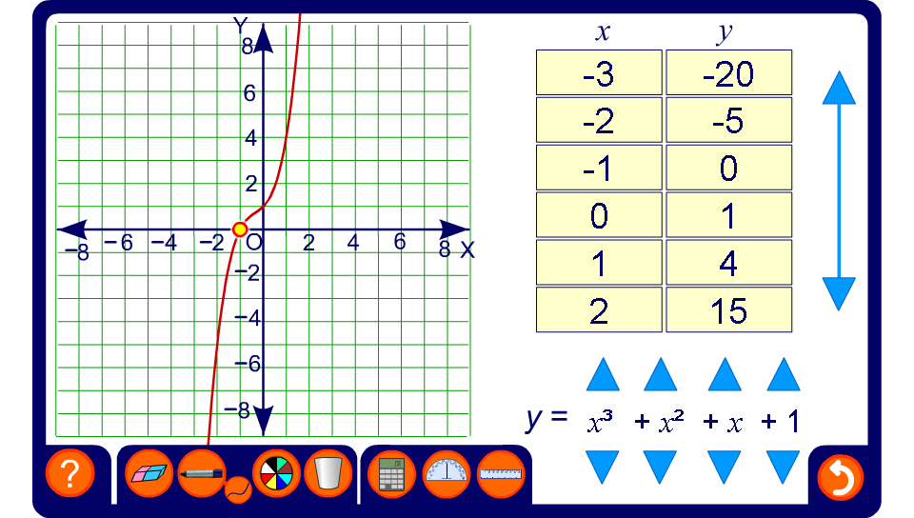


Exploring cubic graphs
Notes:
Point out the basic features of the cubic graph. Draw particular attention to its rotational symmetry and to the position of its turning points.
Explore the effect of changing the coefficients of x³, x² and x and the constant value.
The coordinates of the x- and y-intercepts can be revealed if required. Discuss how the values of these points can be found by putting x or y equal to 0 in the function and solving the corresponding equation.

